Slide 1

Team Name : AIA
Team Leader Name : Aditya Chimurkar
Problem Statement : Track 1 - Intelligent Candidate Discovery & Ranking (The Data & AI Challenge): rank a pool of 100,000 profiles against one job description into a precise, explainable top-100 shortlist - beyond keyword matching.

Slide 2
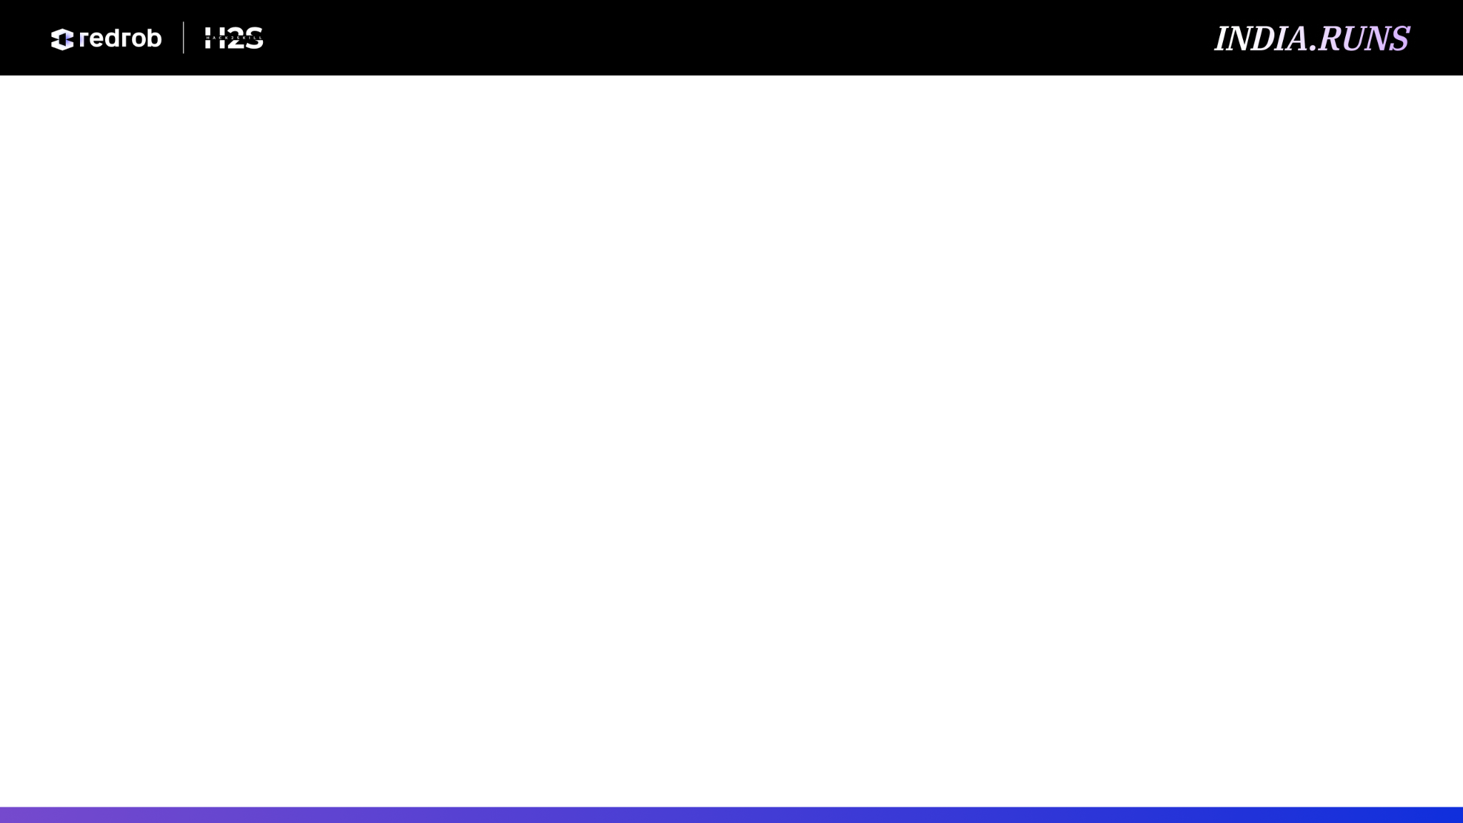
Solution Overview
What is your proposed solution?
A multi-signal candidate ranker: given one JD and 100,000 profiles it returns a validator-exact top-100 shortlist, each row carrying a fact-grounded justification. It models the JD explicitly (must / nice-to-have skills, hard disqualifiers, locations) and scores every candidate by blending SBERT semantic fit on the career narrative, an anchored skill match, and ten career / behavioral features over Redrob's 23 signals. The rank step runs in ~80s for the full 100K on CPU, fully offline.
What differentiates your approach from traditional candidate matching systems?
Traditional systems rank by keyword / embedding similarity - the exact trap this JD calls out. We deliberately down-weight raw similarity and lead with career evidence (did they actually ship the system?) and behavioral availability. JD hard-disqualifiers and a within-profile consistency check act as multiplicative guards, so keyword-stuffers, off-target roles, consulting-only careers and the ~80 planted honeypots sink. Every shortlist row is explainable from profile facts - no hallucinated praise.

Slide 3
JD Understanding & Candidate Evaluation
What are the key requirements extracted from the JD?
Modeled explicitly and auditably (ir/jd_requirements.py), every field traceable to job_description.docx: must-have skills (Python, ML, retrieval / ranking / recsys, NLP-IR), nice-to-haves, hard disqualifiers (consulting-only, pure research, CV / speech / robotics without NLP-IR, off-target roles e.g. marketing), 'shipped-systems' evidence phrases, target locations, the 5-9 year experience band, and notice / availability preference.
Which candidate signals matter most? / How do you evaluate fit beyond keyword matching?
Shipped-systems evidence in role descriptions outweighs skill-list keywords; product-vs-services trajectory, role coherence and skill credibility (proficiency x endorsements x usage x assessment score) carry the most weight. SBERT reads the career narrative, so 'built the system that ranks what users see' scores as a strong fit even without the word 'RAG'. Behavioral availability breaks ties; because presence of a skill is not proficiency, the raw keyword / skill match is intentionally down-weighted.

Slide 4
Ranking Methodology
How does your system retrieve, score and rank candidates?
Each candidate is scored against the JD as a weighted blend of normalized signals; hard guards are then applied multiplicatively, and the top-100 is exported under the official validator rules (unique ranks, non-increasing score, tie-break by candidate_id). No labels ship with the data, so the ranker is unsupervised by default - it can switch to a learned XGBoost ranker (fit / save / load) when labels exist.
What models, algorithms or heuristics are used?
SBERT bi-encoder all-MiniLM-L6-v2 (384-dim) for semantic fit; an anchored skill matcher ('java' is not 'javascript'); a 10-feature career / behavioral library; a within-profile consistency / honeypot detector. An optional cross-encoder pass is wired but off by default - it lowered our composite (0.98 -> 0.94), as a generic relevance model misses the career reasoning this JD rewards.
How are multiple candidate signals combined into a final ranking?
All signals are normalized so weights stay interpretable, blended into a base score (raw similarity kept deliberately light), then multiplied by guard penalties (disqualifier + consistency). Weights are human-tuned and inspectable - no black box.

Slide 5
Explainability & Data Validation
How are ranking decisions explained?
Every shortlist row carries a 1-2 sentence justification (ir/reasoning.py) composed only from facts in the profile, with tone matched to rank and honest concerns (notice period, relocation, sub-band experience) surfaced. The sandbox exposes a per-signal breakdown behind each score.
How do you prevent hallucinations or unsupported justifications?
Reasoning is fact-composed from structured profile fields, not free-form LLM generation - it can only state what is in the data, so unsupported praise is impossible. The ranking step makes no LLM / API calls at all.
How do you handle inconsistent, low-quality or suspicious profiles?
A within-profile consistency check flags impossibilities ('expert' skill with 0 months use; tenure exceeding the role's date span) and the honeypot guard down-ranks the ~80 planted traps - both applied as multiplicative penalties, so a keyword-perfect but impossible profile can't be rescued. Honeypot detection is never revealed in the output; traps are silently down-ranked.

Slide 6
End-to-End Workflow
What is the complete workflow from JD input to ranked candidate output?
1. JD modeled once into an auditable requirement set (skills, disqualifiers, locations).
2. prepare.py precomputes the SBERT model download + 100K embedding cache (one-time; offline thereafter).
3. Each profile -> schema-independent Candidate; the semantic surface is built from summary + role descriptions.
4. Score = normalized blend of semantic fit + anchored skill match + 10 career / behavioral features.
5. Multiplicative guards applied: JD hard-disqualifiers + within-profile consistency / honeypot check.
6. Fact-grounded reasoning generated per candidate.
7. Sort, take top-100, export the validator-exact CSV (rank.py -> submission.csv) in ~80s on CPU, offline.

Slide 7
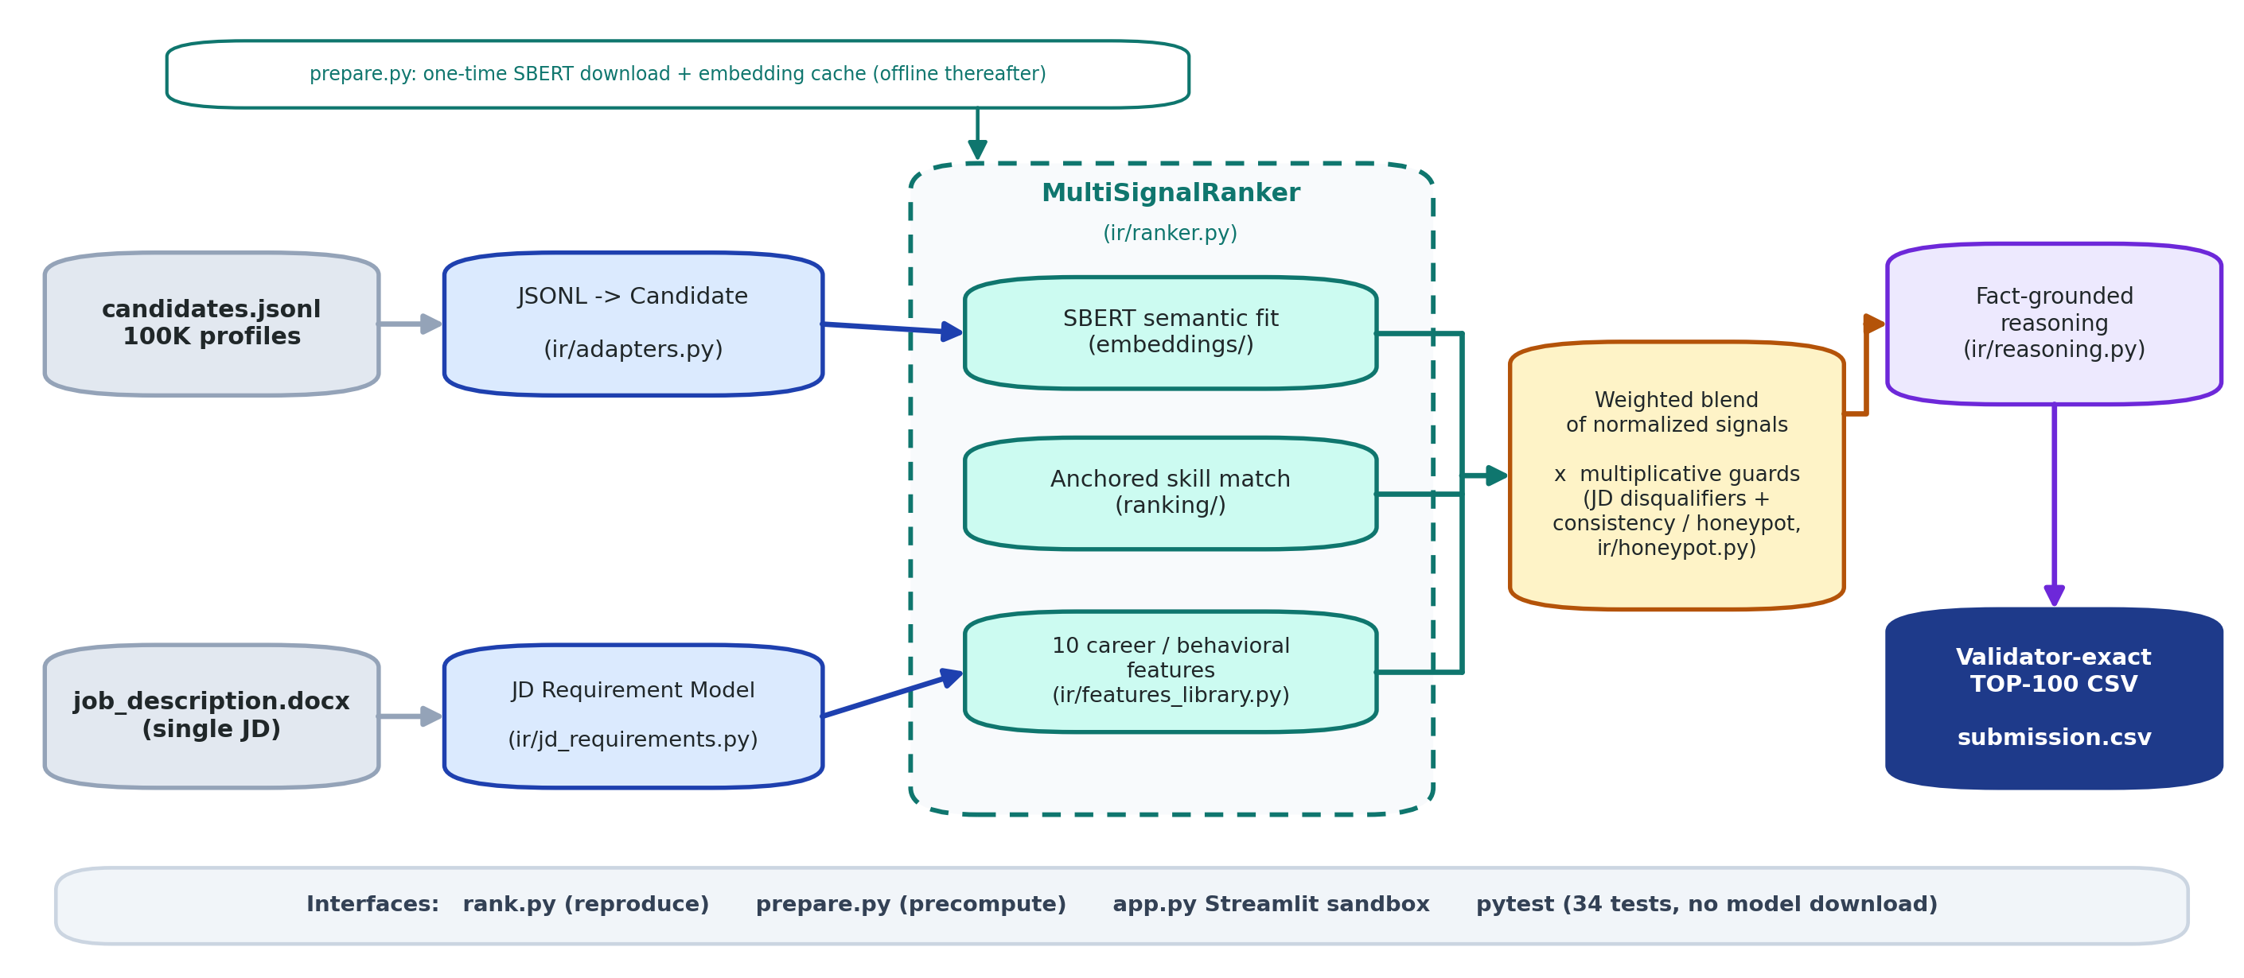
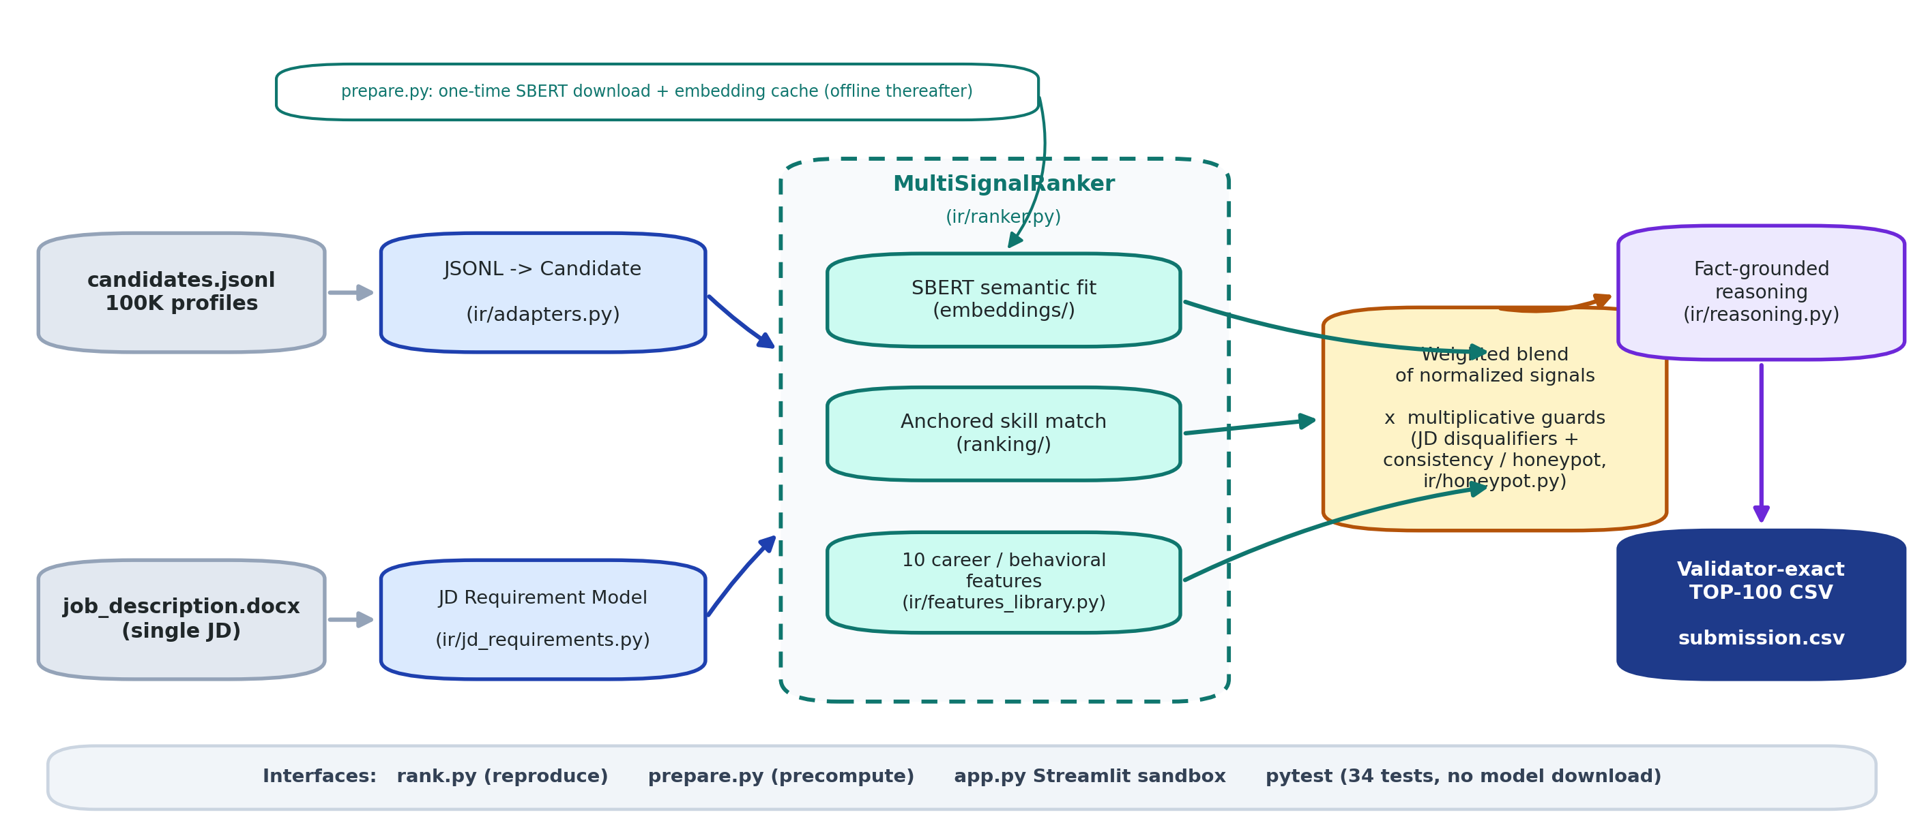
System Architecture

Slide 8
Results & Performance
What results or insights demonstrate ranking quality?
Validated against a JD-grounded judgment set (ideal fit, keyword-stuffer, plain-language fit, inactive, consulting-only, pure-research, honeypot) on the official composite 0.50*NDCG@10 + 0.30*NDCG@50 + 0.15*MAP + 0.05*P@10: SBERT composite ~0.984, NDCG@10 0.984, 0% honeypots in the top 10. On the real 100K, submission.csv passes validate_submission.py with 0 honeypot-suspect and 0 hard-disqualified profiles in the top 100 (Stage-3 DQ threshold is >10%). The 34-test suite passes with no model download.
How does your solution meet the challenge's runtime and compute constraints?
The rank step is ~80s for the full 100K on CPU, offline, <=0.3 GB heap - well inside the 5-minute / 16-GB limit. SBERT model download + embedding cache is a one-time precompute (~25 min); after it, ranking is CPU-only with no network calls.

Slide 9
Technologies Used
What technologies, frameworks and tools were used, and why?
- Python 3.14 - core implementation.
- sentence-transformers / all-MiniLM-L6-v2 (SBERT) - 384-dim semantic fit on the career narrative; small and CPU-friendly, and it beats keyword matching.
- PyTorch (CPU) - SBERT backend, no GPU required.
- scikit-learn / NumPy - HashingVectorizer + TF-IDF fallback embedder, learned-ranker hook, and vectorized scoring / normalization.
- FAIMR core (MIT, vendored) - retrieval / ranking primitives, cross-encoder, anchored skill matcher and evaluation metrics.
- Streamlit + Docker - self-contained, free-deployable sandbox (app.py) and a reproducible image.
- pytest - 34 tests that run without any model download.
Why: every component runs offline on CPU inside the compute budget; no hosted LLM / API, so no candidate data leaves the machine and the ranking is deterministic and reproducible.

Slide 10
Submission Assets
- GitHub repository: https://github.com/NotArnav03/india-runs
- Live sandbox (Streamlit): https://indiarunsaia.streamlit.app
- Reproduce: pip install -r requirements.txt -> python prepare.py --candidates ./candidates.jsonl -> python rank.py --candidates ./candidates.jsonl --out ./submission.csv
- Output: submission.csv - validator-exact top-100; passes the official validate_submission.py.
- Documentation: README.md (methodology + architecture) . docs/GAP_ANALYSIS.md (dataset-grounded build log).
- Demo video: [ add link before submitting ]

Slide 11


